Slide 1


Task on 2nd week day 1 automation
KVS CHARAN(T1735)
A Quest Global Company

Slide 2
1: What does java compiler and interpreter do?
Compiler
A compiler in Java translates the entire source code into a machine-code file or bytecode, and that file is then executed. It is platform-independent.
A bytecode is basically an intermediate code generated by the compiler after the compilation of its source code. Java compiler can be operated by using the Javac.exe command from the command prompt.
Javac.exe is the extention for the java program to execute that code that is before execution.
Interpreter
An interpreter is a type of computer program that directly executes instructions written in a programming or scripting language, without requiring the code to be compiled into machine language first.
The interpreter processes and executes code line-by-line or statement-by-statement or instruction-by-instruction during runtime.

Slide 3
2: What is variable in java?
Variable is named memory location, we have local, instance, static, global variable.
Local variable is a variable that is declared inside a block of code.
static variables are declared with the static keyword inside a class.
These are variables declared inside a class.
Java does not have true global variables because all variables in Java must be defined inside a class. In java global variable in Java can be implemented using static variables.

Slide 4
3: What is internet and how it is used?
Internet is networking system that is connected to many webservers and it is used by accessing through servers.
In general, the internet can be used to communicate across large or small distances, share information from any place in the world, and access information or answers to almost any question in moments.
It is used to get any information and does not restricted to particular one and all the servers would be handled using the cloud because lot more information need to store and for that storage we need many hardware storage units which is not possible in reality.

Slide 5
4: What is object in java?
It is a real-world entity that contains both state and behavior. The state of an object is represented by fields also known as attributes or properties.
bike naaBike=new bike(“Honda Shine sp”, ”Yellow”, 2021);
In the above instruction naaBike is the object, bike is class name.

Slide 6
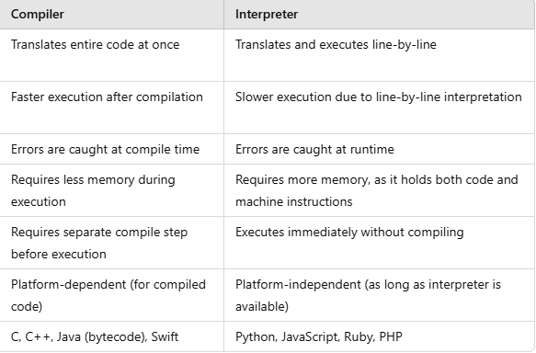
5: What is difference between compiler and interpreter?
Compiler
A compiler translates code from a high-level programming language into machine code before the program runs.
Interpreter
An interpreter translates code written in a high-level programming language into machine code line-by-line as the code runs.

Slide 7
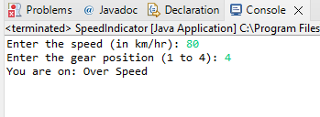
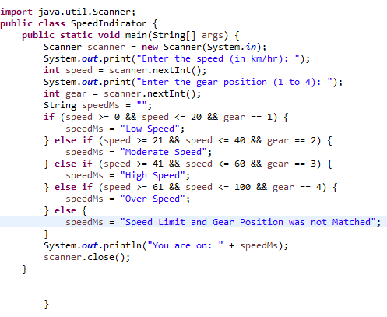
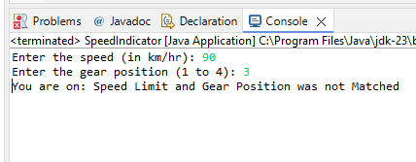
6: Code that Speed Indicator Message at different speed and gears.
Output with correct inputs
Output with incorrect inputs

Slide 8


